Slide 1


DATA ANALYSIS: SUICIDE RATE
PREPARED BY:
NAME:DHRUVI PADHIAYR
ROLL NO: 09
BATCH: F1 BRANCH: IT

Slide 2
Project outline
Idea that lead to the concept
The idea of analyzing suicide rates has been driven by a desire to understand and address the complex social and psychological factors that contribute to suicide. The concept of analyzing suicide rates through data analysis emerged in the 19th century, when statistical methods began to be used to study social phenomena.
Functionality
1) Identifying trends and patterns
2) Evaluating interventions
3) Predicting suicide risk
Components used
Jupyter
MS EXCEL

Slide 3
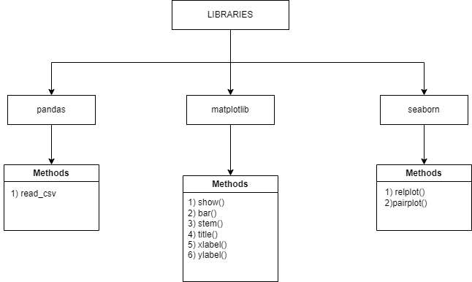
Circuit / Block diagram

Slide 4
Merits / Demerits
Merits:
Improved understanding
Public awareness
Evaluation of invention
Demerits:
Limited data
Ethical concerns
Reliability on data
References:
www.kaggle.com
Future scope:
Can be helpful to publish paper

Slide 5
THANK YOU

